Slide 1
Presentation video
David Sanmiguel
Technology Software Analysis and Development.
Teacher:
Sandy Paola Cuesta Parra
Activity:
AA1-EV02 Video

Slide 2
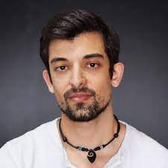
Personal information
Federico Palomares
Address: Carrera 15 # 53 - 43
Phone Number: 3224282443
Profession:
Programming Student
Age: 27 years
Hobbies: jogging, read books

Slide 3
Federico is Programming Student in the university UIS through of the Misión Tic 2022.
He and I are developers in the same proyect, it’s a proyect about of a Music app in Web and Mobile plattaforms. He is Software Designer
In this proyect and his responsibilities are:
Design, develop and execute test plans.
Recommend improvements to optimize performances.
Design and implement test scripts.

Slide 4
Office activities
Actually, we are development a Web App so, Federico everyday writes the code to the Web app and he check out the Responsive Design.
He develop test scripts and every weekend we all meet for review progress.
Sometimes he have to run funcionality test to Web app.
Kiko don’t work everyday because, it’s a personal proyect and it isn’t his job of full time.

